Slide 1
The Fluid Elastic Instability of Concentric Arrays of Tube Bundles Subjected on Cross Flow
Presenter: Wei Xu
Tianjin University, China

Slide 2
CONTENTS
Introduction
Introduction
Experiments of FEI
Numerical simulation of FEI
Results and discussion
Conclusions

Slide 3
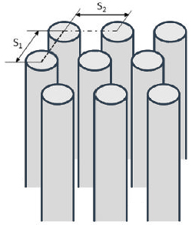
Introduction
Concentric tube arrays
Widely applied in nuclear industry
Focus on
cross flow
Flow induced vibration (FIV)
Focus on
the axial direction
Fluid elastic instability (FEI)
the radial direction
Fig.1 Schematic of concentric tube arrays

Slide 4
Introduction
Experimental Studies of FEI
Tanaka and Takahara
Chen et al.
Since 1960s
Grover and Weaver
Pettigrew and Taylor
Prakash et al.
The FIV measurements carried out in 60-degree angle sector model of concentric array tube bundles
FEI could be expressed simply in terms of dimensionless flow velocity and dimensionless mass-damping
An wind-tunnel facility
Nineteen flexibly tubes in the centre
A number of fluid elastic force coefficients
The unstable fluid forces acting on the tube bundle
Prakash, V., Thirumalai, M., Prabhakar, R., et al, 2009, “Assessment of flow induced vibration in a sodium–sodium heat exchanger,” Nuclear Engineering and Design, 239(1), pp. 169-179. DOI: 10.1016/j.nucengdes.2008.10.007
Chen, S. S., Cai Y., and Zhu S., 1996, “Flow-Induced Vibration of Tubes in Cross-Flow,” Journal of Offshore Mechanics and Arctic Engineering, 118(4), pp. 253-258. DOI: 10.1115/1.2833913
Pettigrew, M. J., and C. E. Taylor, 1991, "Fluidelastic instability of heat exchanger tube bundles: review and design recommendations," Journal of pressure vessel technology, 113(2), pp. 242-256. DOI: 10.1115/1.2928752
Grover, L. K., and D. S. Weaver, 1978, “Cross-flow induced vibrations in a tube bank—vortex shedding,” Journal of Sound and Vibration, 59(2), pp. 263-276. DOI: 10.1016/0022-460X(78)90505-9
Tanaka, H., and S. Takahara, 1981, “Fluid elastic vibration of tube array in cross flow,” Journal of sound and vibration, 77(1), pp. 19-37. DOI: 10.1016/S0022-460X(81)80005-3

Slide 5
Introduction
Numerical simulations of FEI
Since 1990s
Hassan et al.
Commercial CFD simulation software ANSYS CFX
The FEI of flexible tube bundle in two-dimensional scale
Two-dimensional LES model
Omar
Omar, Hossin, 2012, “Numerical Simulations of Fluidelastic Instability in Tube Bundles,” University of New Brunswick (Canada).
Hassan, Yassin A., and Ibrahim Wael A., 1997, “Turbulence prediction in two-dimensional bundle flows using large-eddy simulation,” Nuclear technology, 119(1), pp. 11-28. DOI: 10.13182/NT77-A35391

Slide 6
Introduction
The defects of current research
Experiments
No criterion that can ubiquitously and accurately predict the FEI of the tube bundle in all cases
Lack of studies on concentric arrays of tube bundles
The influence of measurement methods on the flow field
Numerical simulations
Few study regarding tube bundle vibrations
Difficulties in the realization of fluid-structure interaction

Slide 7
Introduction
Research approaches
FEI of concentric arrays of tube bundles
A set of visualized vibration measurement system
A comparative study by CFD
Critical velocity, vibration frequency, amplitude and main vibration direction
The guidance on design and operation

Slide 8
CONTENTS
Introduction
Experiments of FEI
Experiments of FEI
Numerical simulation of FEI
Results and discussion
Conclusions

Slide 9
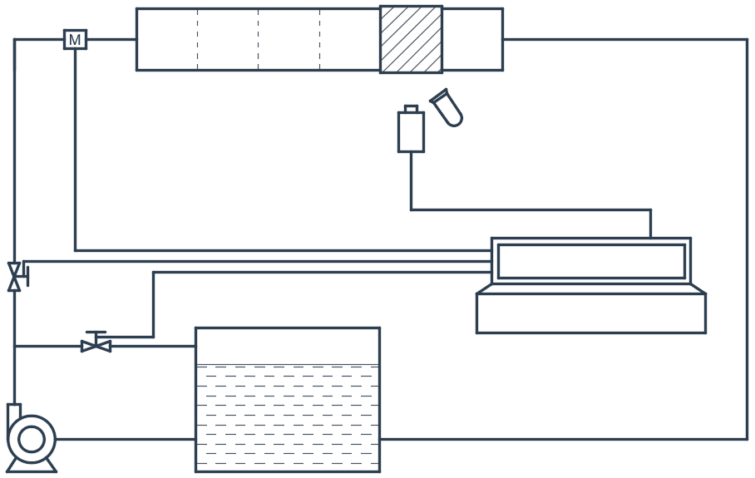
Experiments of FEI
The visual vibration measurement system
magnetic flow meter
water tunnel
test segment
pipelines
A test tube bundle
A water tunnel test system
A visual image processing system
A data processing system
perforated plate
high-frequency floodlight
high-speed camera
globe valve
Data acquisition system
Innovation points
centrifugal pump
water tank
Fig.2 Schematic of the visual vibration measurement system

Slide 10
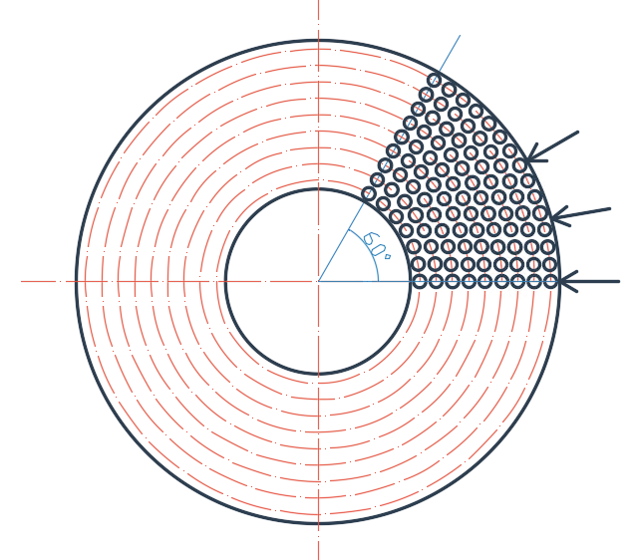
Experiments of FEI
Test tube bundles
Flexible tube: aluminum alloy
30-degree angle
15-degree angle
0-degree angle
Rigid tube: steel; natural frequency of 140.6 Hz
Fig.3 Tube bundles
Concentric arrays
60-degree angle as a cycle
3 representative incident angles
Radial/circumferential pitch of 33.6/36.4 mm
Fig.4 Tube specimens

Slide 11
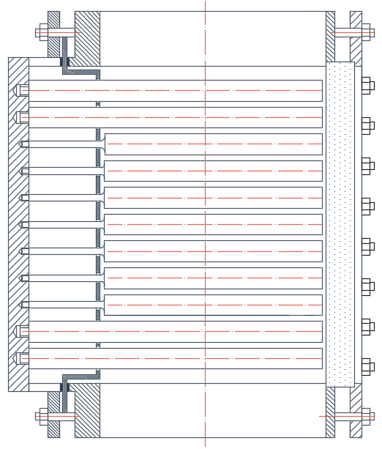
Experiments of FEI
Water tunnel test system
Tubes were placed horizontally in order to facilitate the vibration test
The effect of gravity is small and negligible
The turbulence intensity is less than 5% through the steady-flow zone in the upstream
Fig.5 Cross-sectional schematic of test section

Slide 12
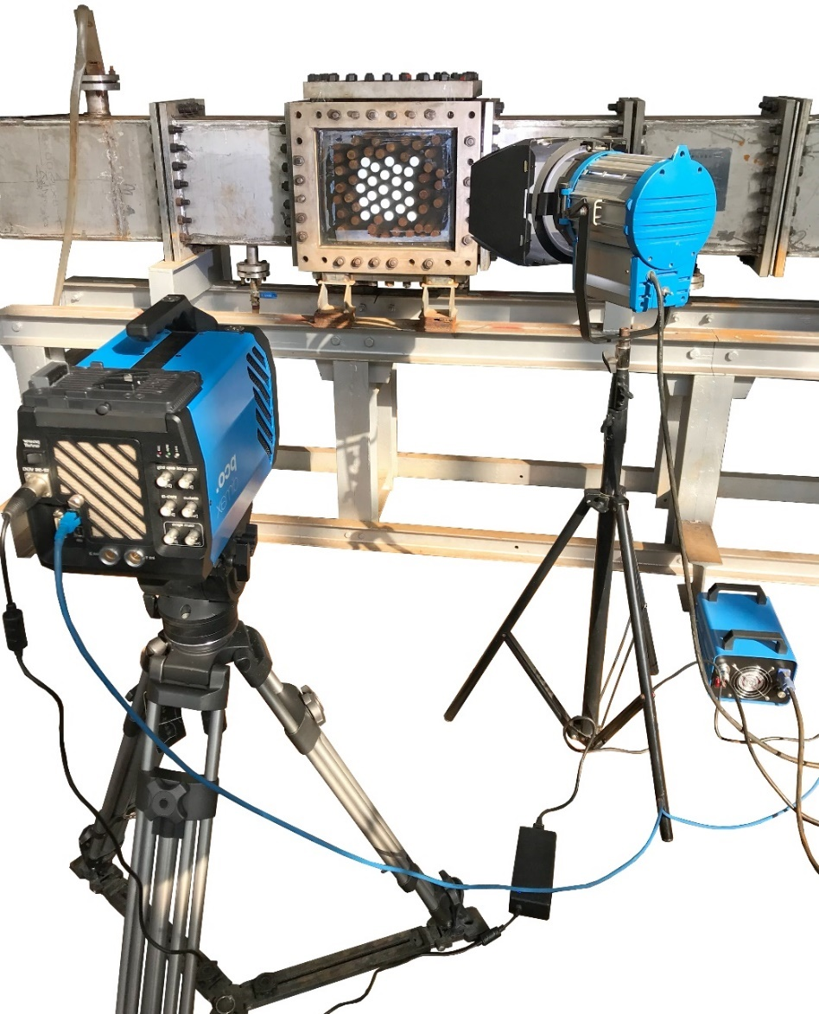
Experiments of FEI
Visual image processing system
test section
high-frequency floodlight
Sampling frequency:
400 Hz
High-frequency floodlight:
the guarantee of clear contour
Electric power source:
the supply of high-frequency AC
high-speed camera
electric power source
Fig.6 Visual image processing system

Slide 13
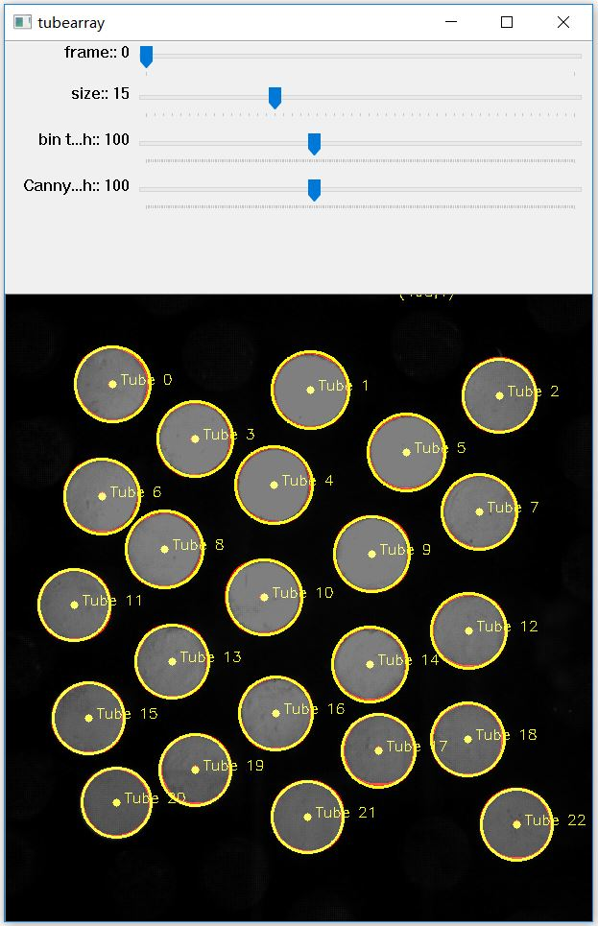
Experiments of FEI
Data processing system
Black-and-white mode
The recognition of flexible tubes
Envelope circles
The motion coordinate information
Fig.7 Data processing software

Slide 14
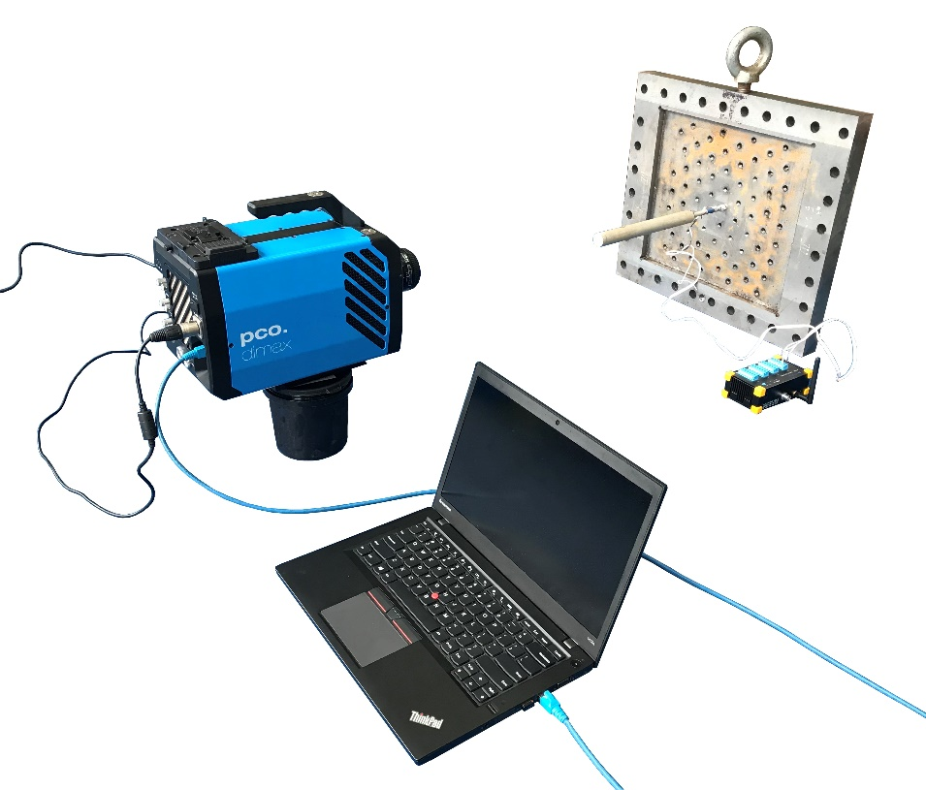
Experiments of FEI
The design of experiments in air
fixed tube plate
high-speed camera
test tube
Free attenuation vibration test
Traditional strain test method
Visual vibration measurement method
wireless dynamic strain collector
data processing center
Fig.8 Free attenuation vibration test device

Slide 15
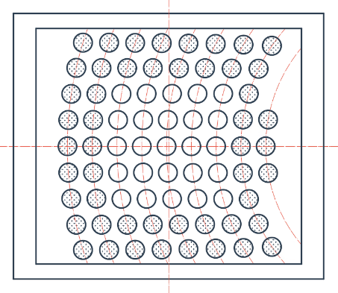
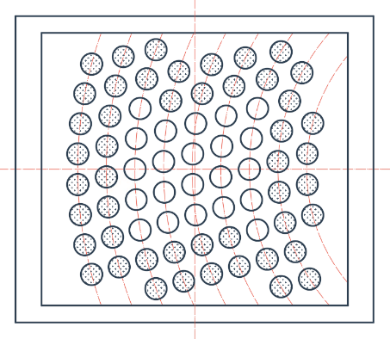
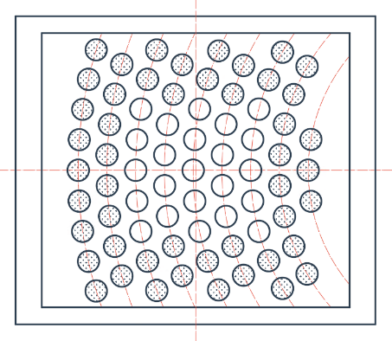
Experiments of FEI
The design of experiments in water
Water tunnel test
In flow velocities: 0-0.97 m/s
Reynolds numbers: 0-3×10⁵
sampling time: at least 60 s
0-degree angle
15-degree angle
Fig.9 Flexible and rigid tubes distribution
30-degree angle

Slide 16
CONTENTS
Introduction
Experiments of FEI
Numerical simulation of FEI
Numerical simulation of FEI
Results and discussion
Conclusions

Slide 17
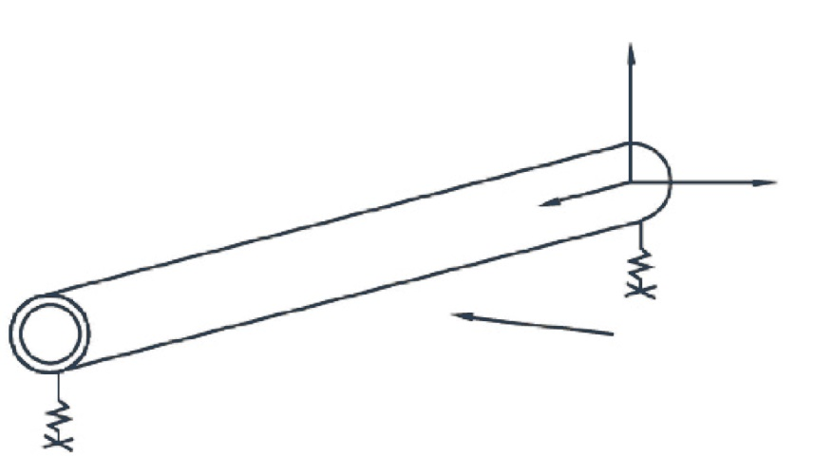
Numerical simulation of FEI
Fluid-structure interaction model
rigid body coordinate
y
ANSYS CFX
Rigid body structure
Dynamic mesh technology
Quasi two-dimensional model
Damping force
x
z
inflow
Fig.10 Rigid body cylinder vibration system

Slide 18
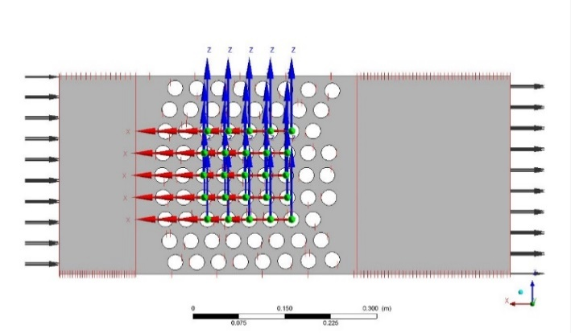
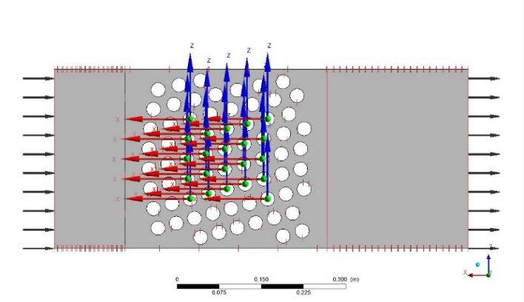
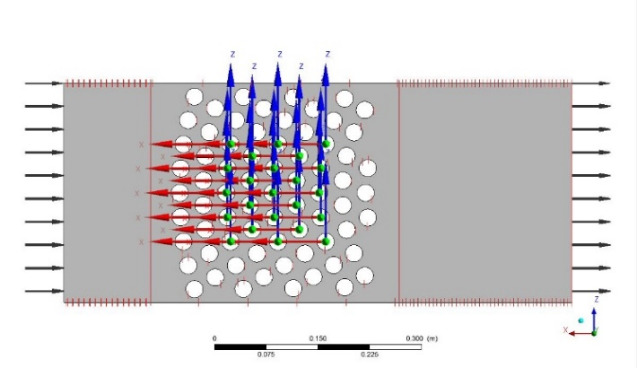
Numerical simulation of FEI
Computational model and boundary conditions
Items | Setup
analysis type | transient analysis
fluid medium | water
turbulence model | LES WALE
inlet condition | even flow
outlet condition | pressure outlet
symmetry surface condition | periodic boundary condition
tube wall condition | rigid body wall, dynamic mesh
wall function | scalable wall function
Fig.11 Numerical simulation models

Slide 19
CONTENTS
Introduction
Experiments of FEI
Numerical simulation of FEI
Results and discussion
Results and discussion
Conclusions

Slide 20
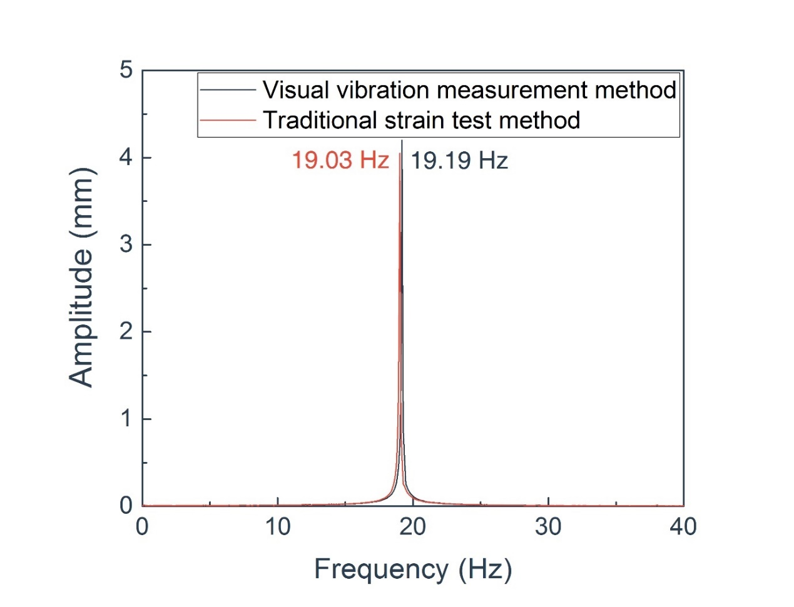
Results and discussion
Free attenuation vibration
Fig.12 Spectrum of free attenuation vibration
Relative error: 0.8%
Visual vibration measurement method √

Slide 21
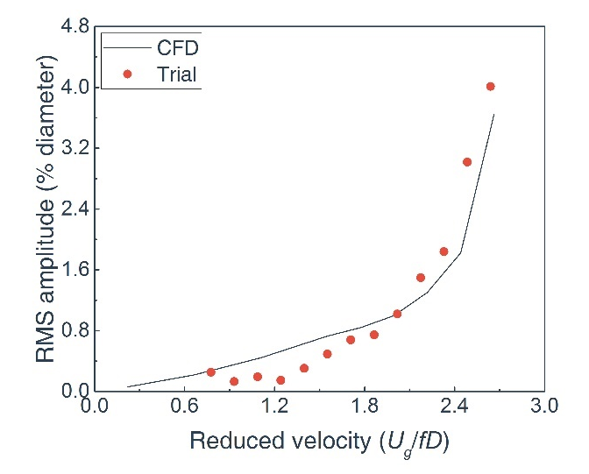
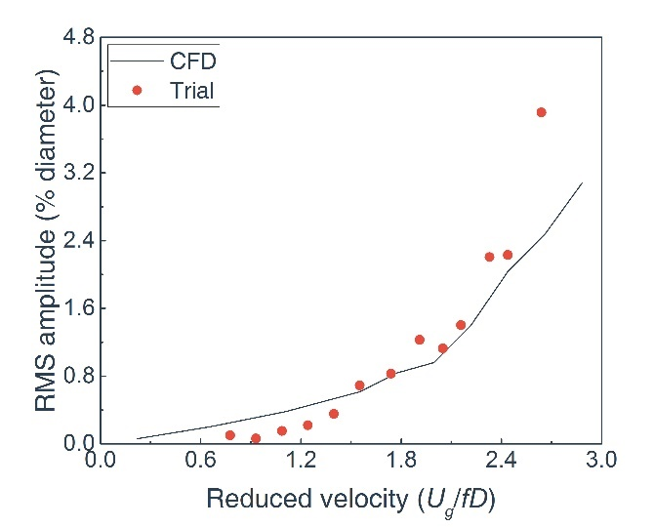
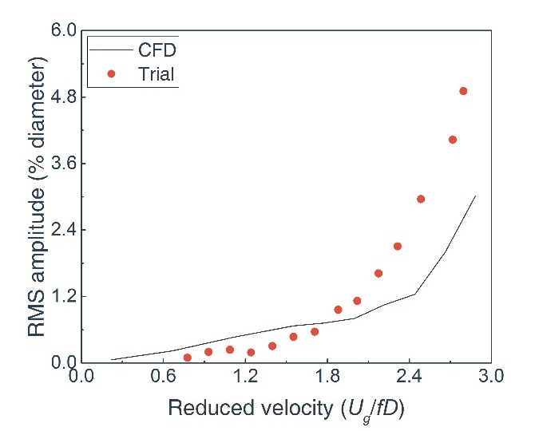
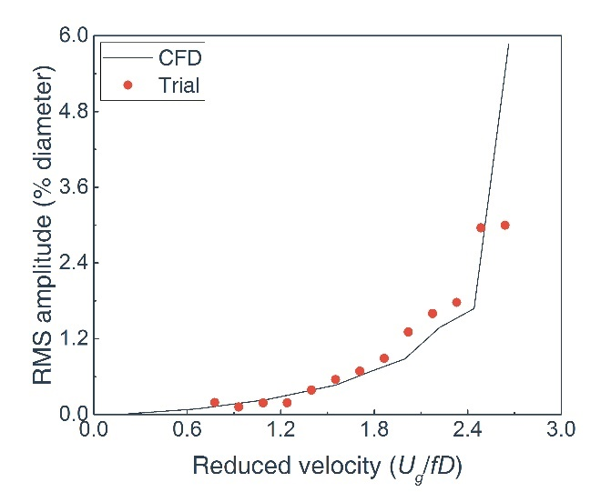
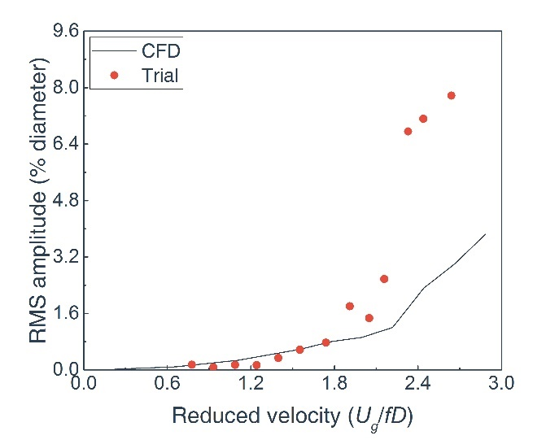
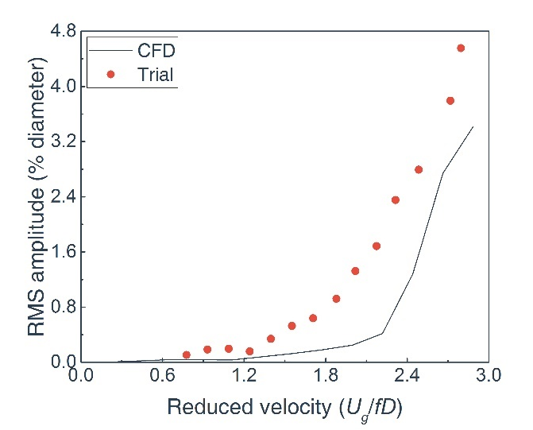
Results and discussion
Critical flow velocity
Relative error: 4.5%
Relative error: 12.5%
Relative error: 12.5%
2.33
Stream-wise
2.17
2.17
2.44
2.44
2.44
Relative error: 4.5%
Relative error: 8.3%
Relative error: 1.9%
2.33
2.17
Cross-stream
2.04
2.44
2.21
2.21
0-degree angle
15-degree angle
30-degree angle
Fig.13 Curve of RMS amplitude to mean gap velocity

Slide 22
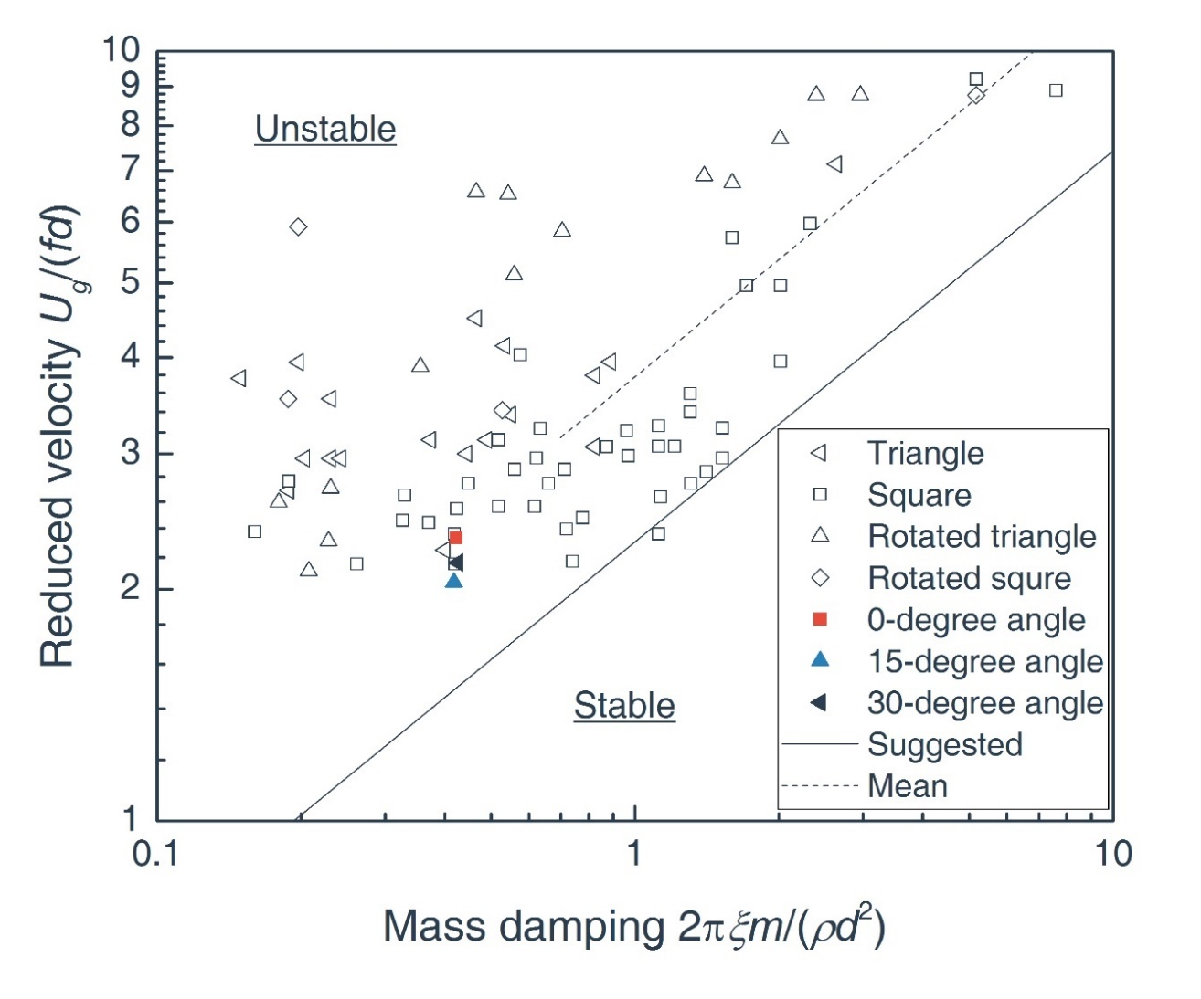
Results and discussion
Stability diagram
Empirical coefficient K = 2.4
Au-Yang, M. K., R. D. Blevins, and T. M. Mulcahy, 1991, "Flow-Induced Vibration Analysis of Tube Bundles—A Proposed Section III Appendix N Nonmandatory Code," Journal of Pressure Vessel Technology, 113(2), pp. 257-267. DOI:10.1115/1.2928753
Fig.14 Stability diagram for tube arrays

Slide 23
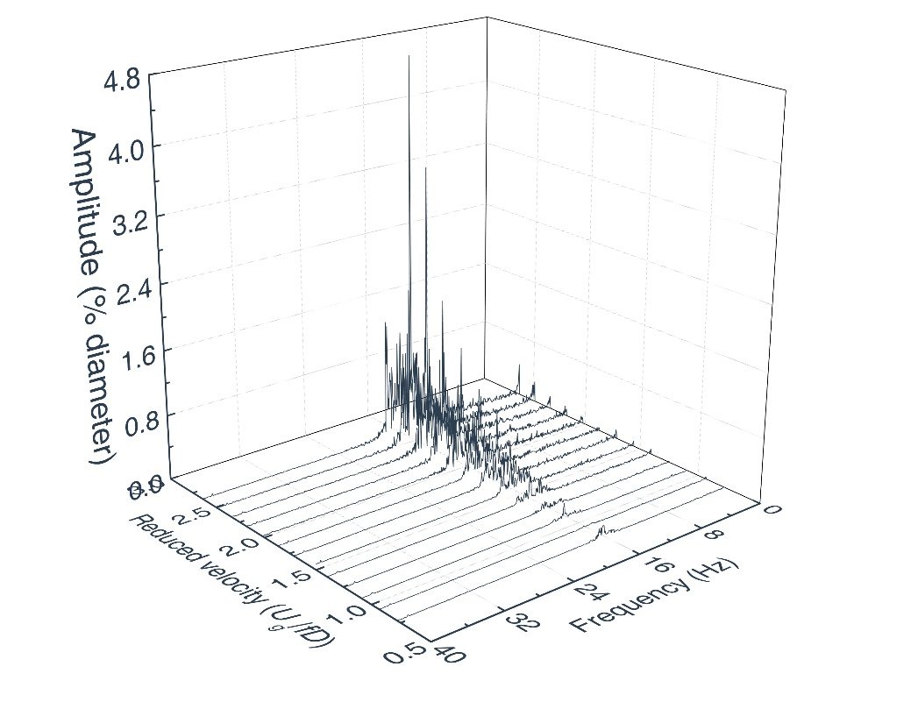
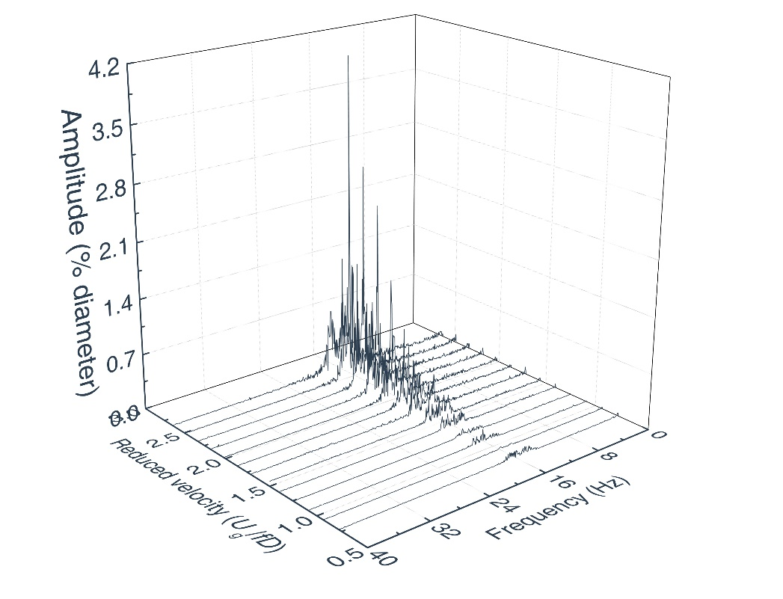
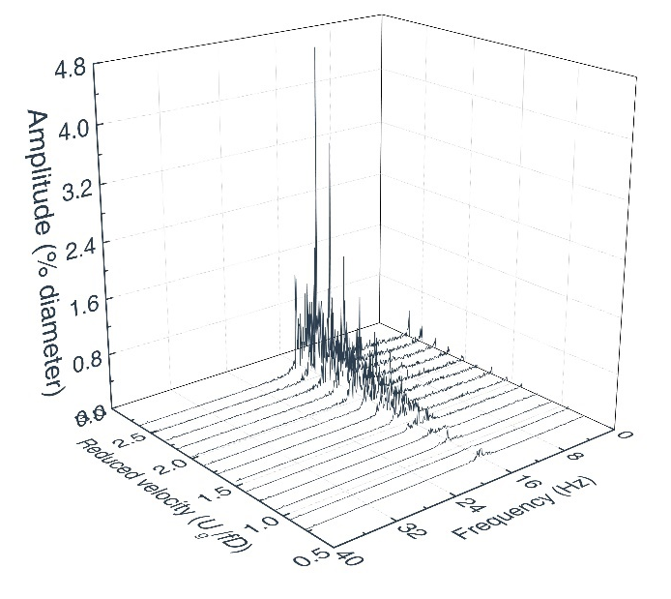
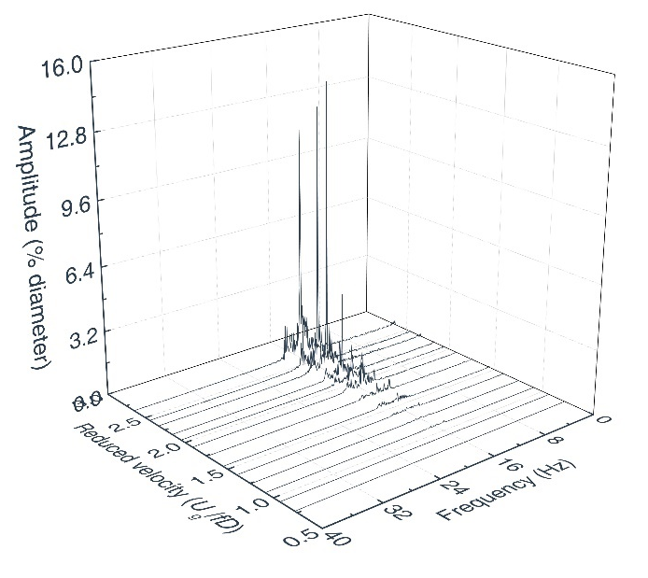
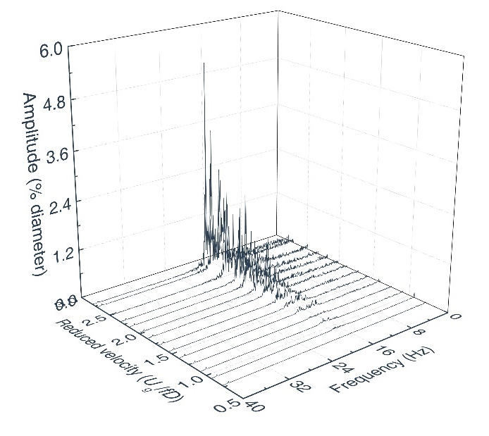
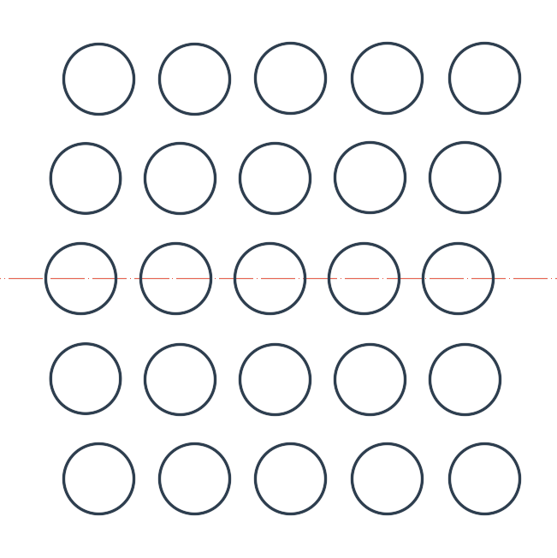
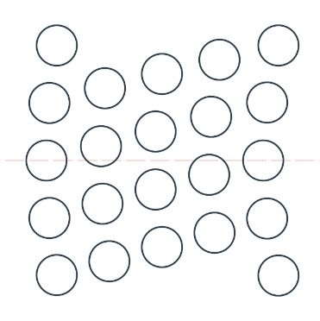
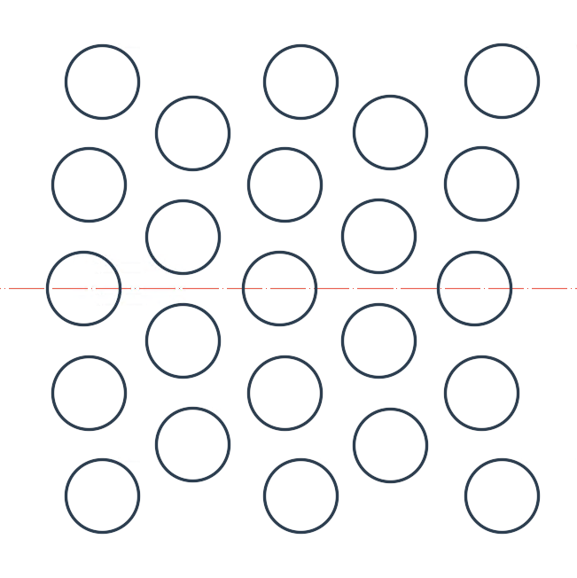
Results and discussion
Spectral response
0-degree angle
15-degree angle
30-degree angle
Cross-stream direction
Stream-wise direction
Static drag effect
Fig.16 Spectral response of tubes in cross-stream direction at different locations
Fig.15 Spectral response of tubes at 0-degree angle arrangement

Slide 24
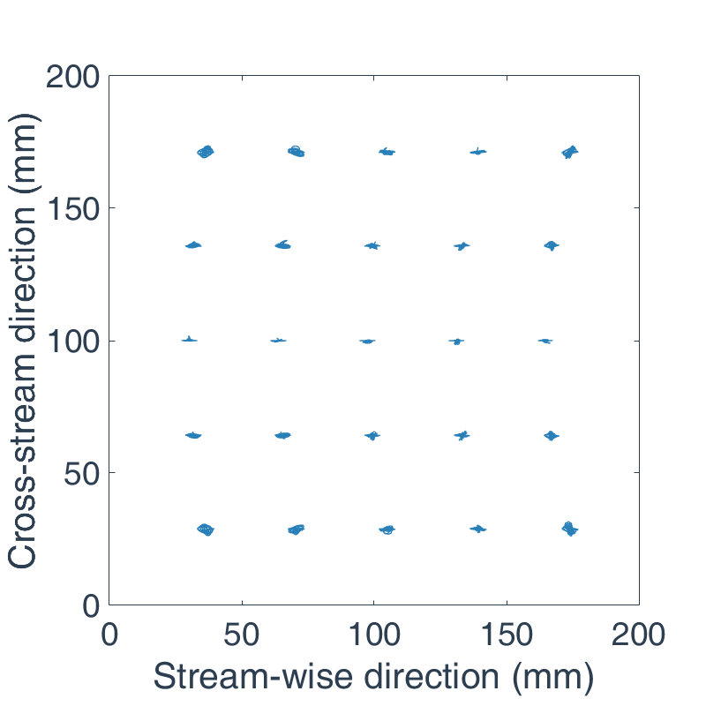
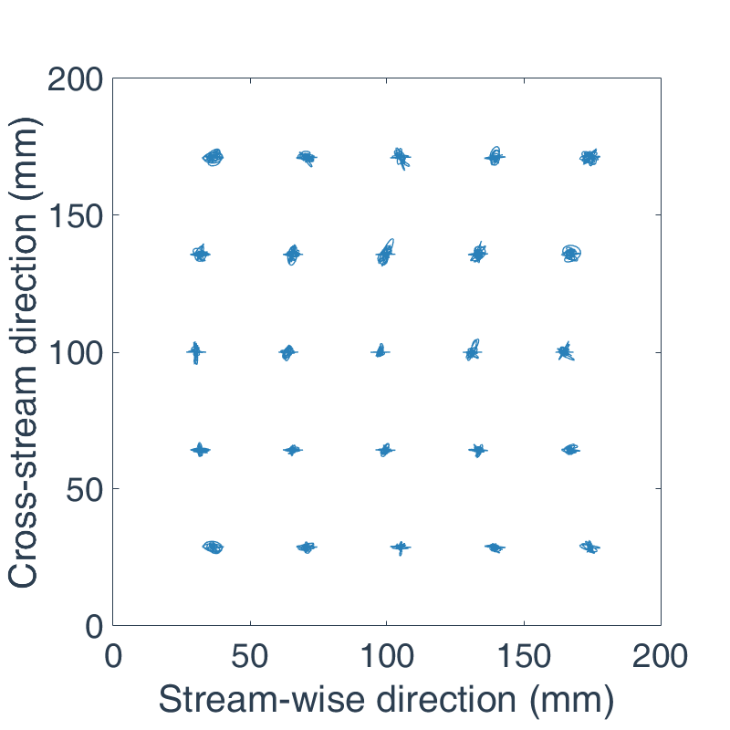
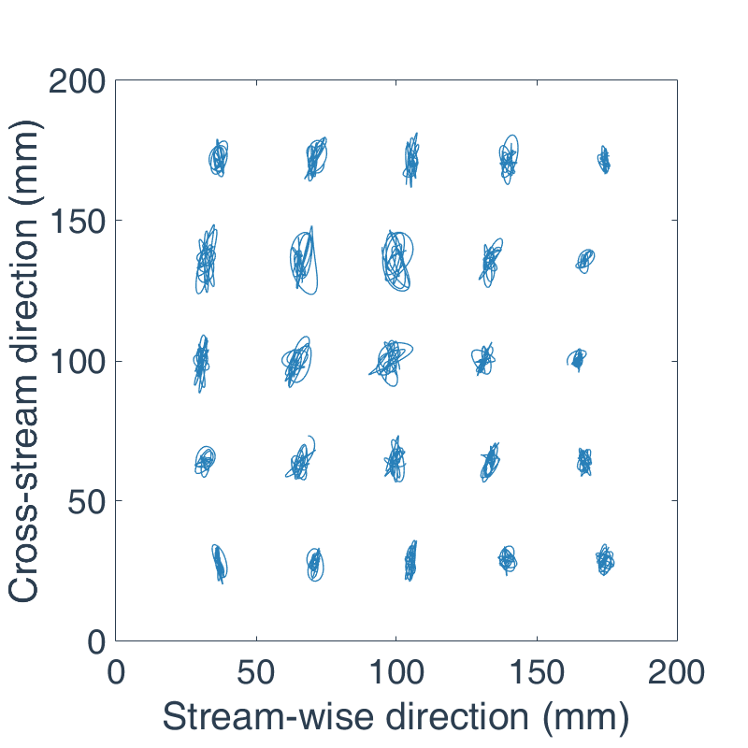
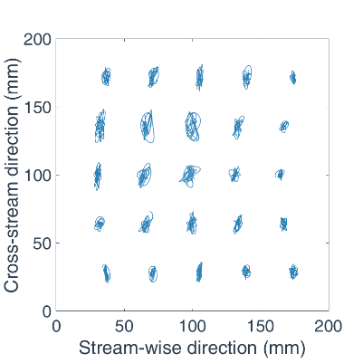
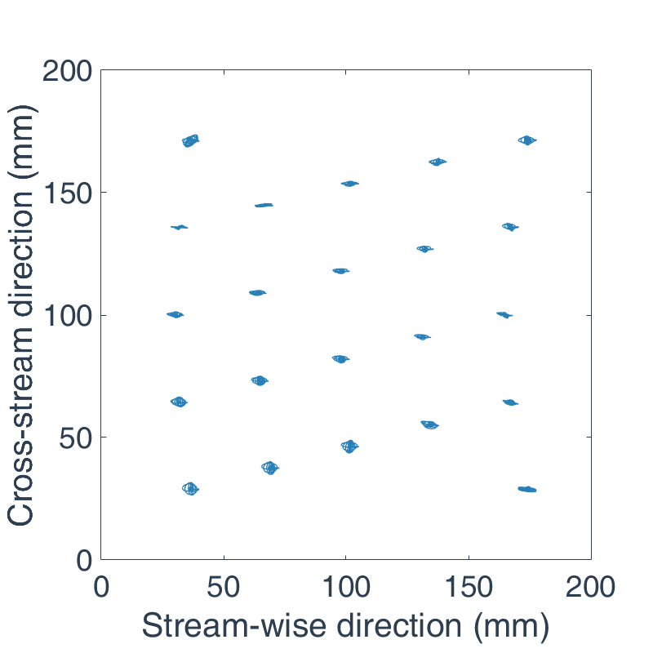
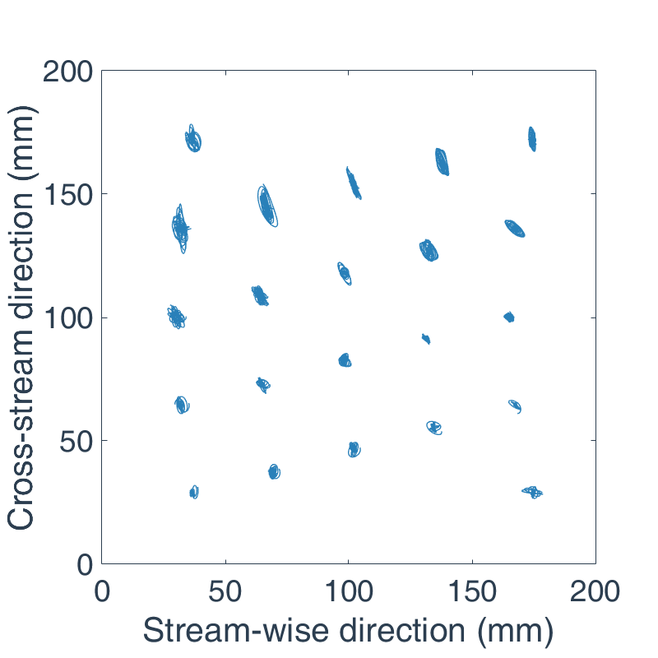
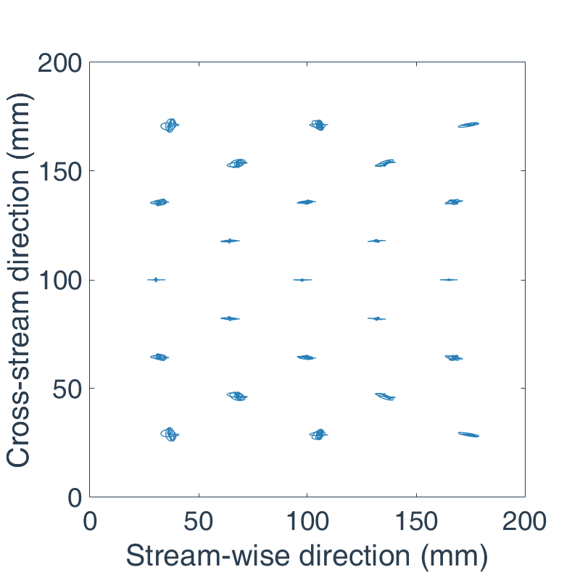
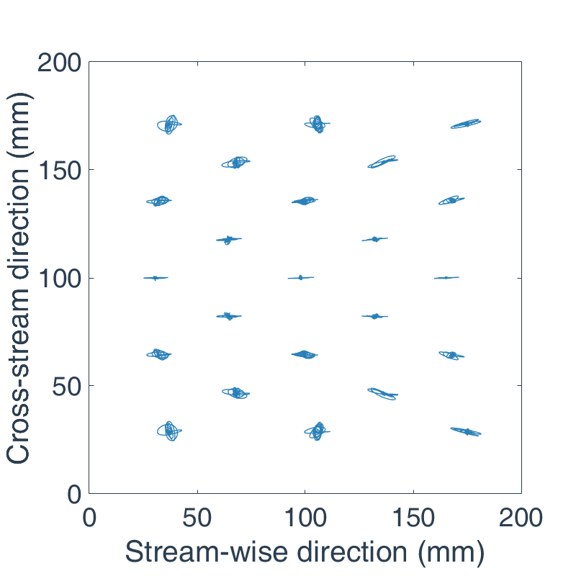
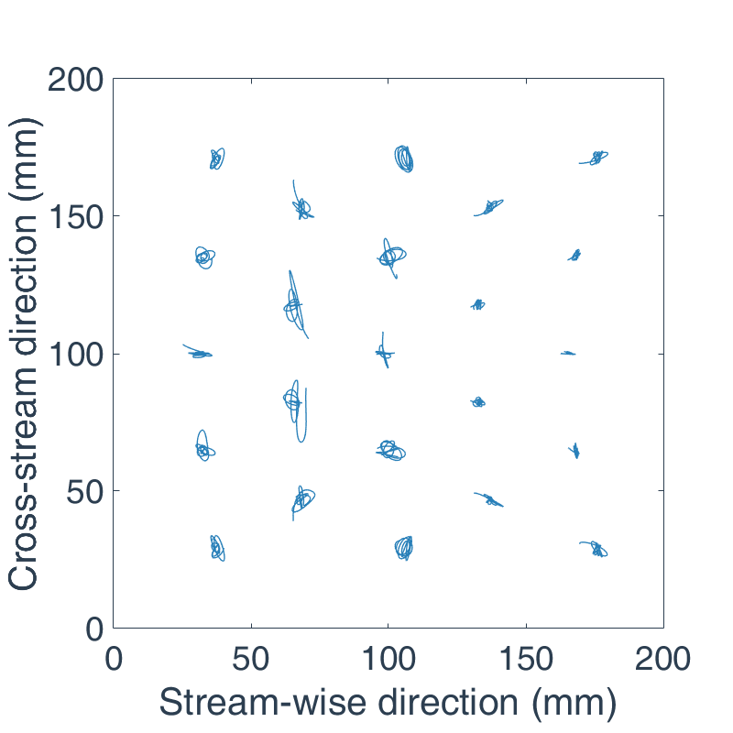
Results and discussion
Main vibration direction
0-degree angle
15-degree angle
Reduced velocity
U_{g}/(fD)
U_{g}/(fD)=2.21
U_{g}/(fD)=2.44
U_{g}/(fD)=2.67
30-degree angle
Fig.18 Tracks of the tube bundles at 0-degree angle arrangement
2.67
2.21
2.44
2.44
2.67
2.88
2.44
2.67
2.88
Fig.17 Tracks of the tube bundles (scale: 2)

Slide 25
CONTENTS
Introduction
Experiments of FEI
Numerical simulation of FEI
Results and discussion
Conclusions
Conclusions

Slide 26
Conclusions
The main conclusions of this study are as follows:
Visual vibration measurement method and traditional strain test method are in good agreement;
The 15-degree angle arrangement is the most unstable location, and the instability occurs firstly in the cross-stream direction;
The static drag effect occurs at the 15-degree angle arrangement;
With the increase of flow velocity, the tube vibration firstly occurs in the stream-wise direction and then in the cross-stream direction. The amplitudes of the front tubes are greater than those of the rear tubes.

Slide 27
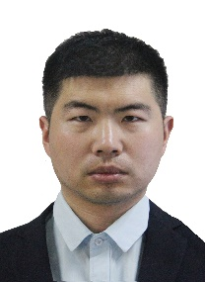
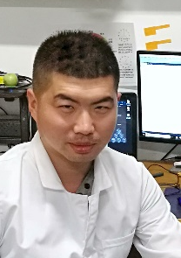
Authors and acknowledgement
Liyan Liu
School of Chemical Engineering and Technology of Tianjin University
Tianjin, China
Wei Xu
School of Chemical Engineering and Technology of Tianjin University
Tianjin, China
Kai Guo
School of Chemical Engineering and Technology of Tianjin University
Tianjin, China
Zhanbin Jia
School of Chemical Engineering and Technology of Tianjin University
Tianjin, China
Yang Wang
School of Chemical Engineering and Technology of Tianjin University
Tianjin, China
Wei Tan
School of Chemical Engineering and Technology of Tianjin University
Tianjin, China
This work was supported by a grant from Lanpec Technologies Limited of China National Machinery Industry Corporation.

Slide 28
THANKS

Slide 29
Supplementary
Accuracy assurance of software
The centroids of the boundaries
The centers of the envelop
Notes:
The boundaries and centroids of tubes are recognized. Envelope circles based on the boundaries of tubes are also generated. The centroids of the boundaries and the centers of the envelope are compared. If the difference between the two is within the acceptable error range, the recognition is considered as accurate.

